Slide 1


Slide 2
Company Profile Incorporated in 2000 by Mr Kishore Chandni, Sunrise Exports is one of the leading manufacturers exporters and suppliers of all types of Kerosene wick stoves. Abiding by the ethical standards and norms of the industry, we bring forth a wide range of Non Pressure Wick Stove. These stoves are available in various dimensions and specifications provided by the customers. To stand tall on the expectations of our valuable patrons, we manufacture these products with high quality material in an advanced manufacturing unit. Advantages of using Kerosene wick stove : 1) Portable 2) Easy to use 3) Easy Maintenance 4) Available with stand, Tank & Top plate

Slide 3
QUALITY
Committed to quality as all our products are subjected to stringent ISO STD TESTS.
Products tested on various parameters.
Quality achieved by number of inspection procedures performed by professional production technicians.
Finest raw materials used in production. Products are met to quality standards before reaching the market.
Regular quality checks conducted to maintain quality standards of the final product that reaches the market.
Dedicated to provide our customers with the finest quality products and services, assuring timely of orders.

Slide 4
Factors which have helped us in creating niche in a short span of time
Quality goods
Timely delivery
Customer satisfaction
Easy mode of payment
Professional team of workers
Large clientele base

Slide 5
OUR CLIENTELE
West Africa
South Africa
Central Africa
Middle East Countries

Slide 6
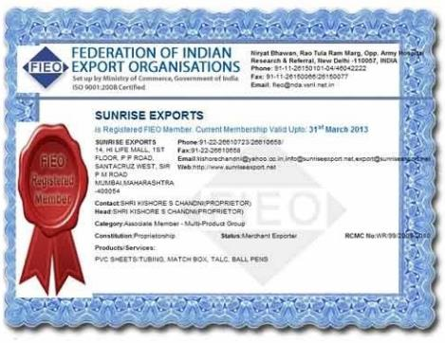
Memberships We are registered members of the federation of Indian export organization, Govt of India.

Slide 7
COMPANY USP
Installation Training
Onsite Support
Operational Training
User Manual
Experienced R & D Department
Large Production Capacity
Large Product Line
Best Testing Facilities

Slide 8
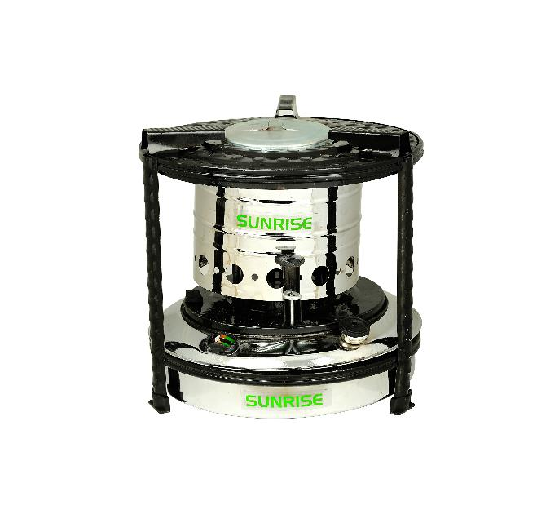
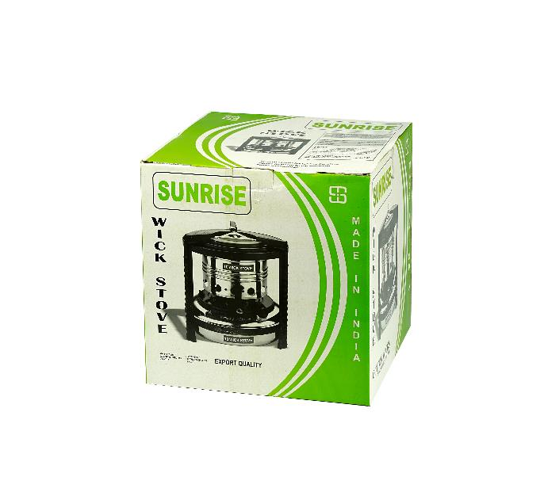
KEROSENE WICK STOVES CHROME PLATED

Slide 9
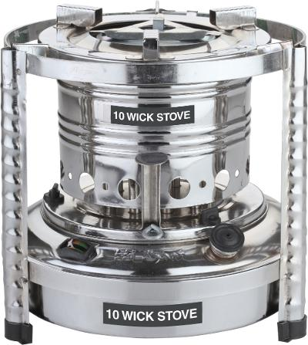
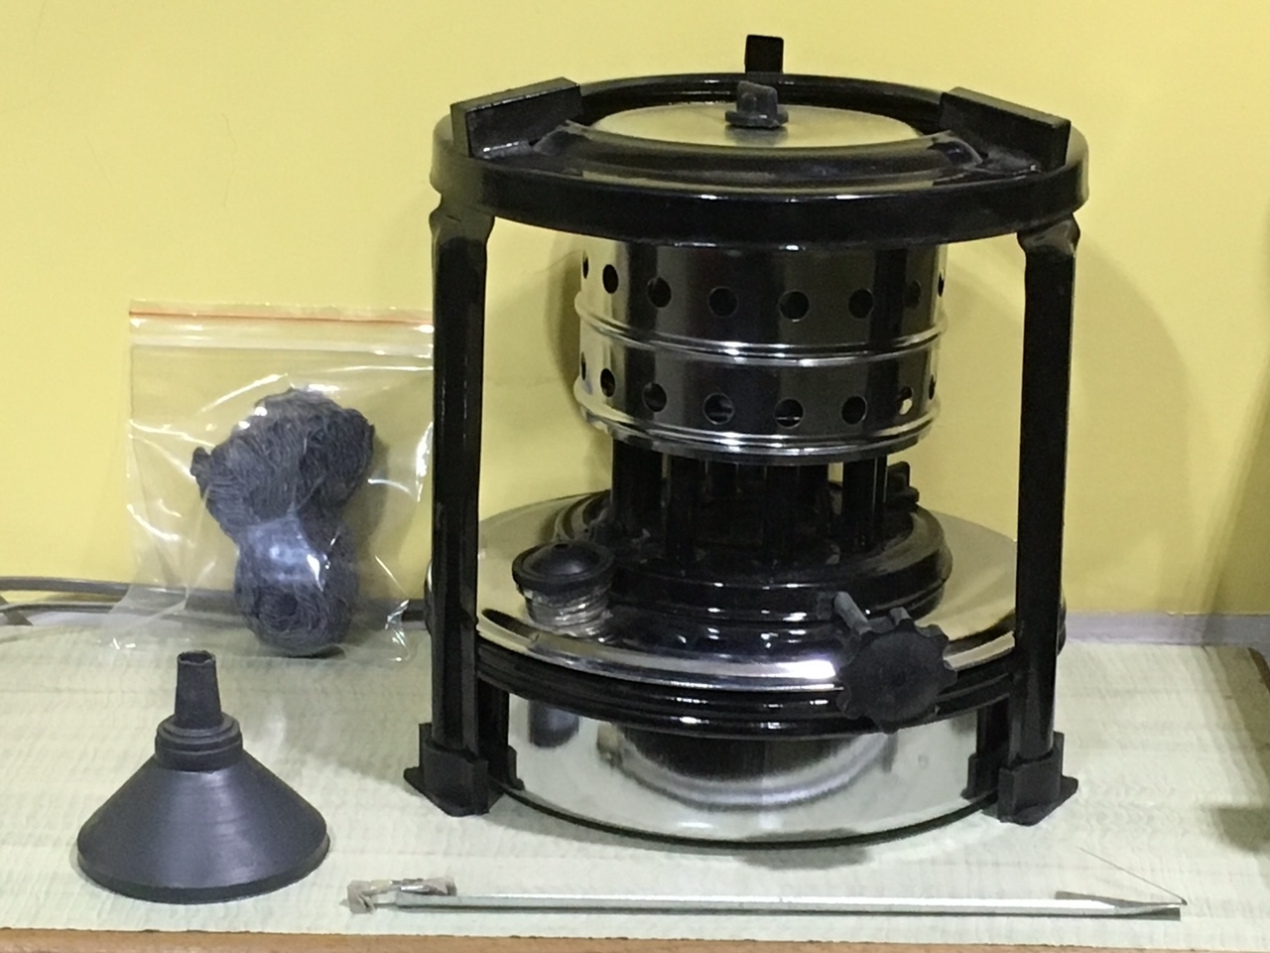
KEROSENE WICK STOVES CHROME PLATED

Slide 10
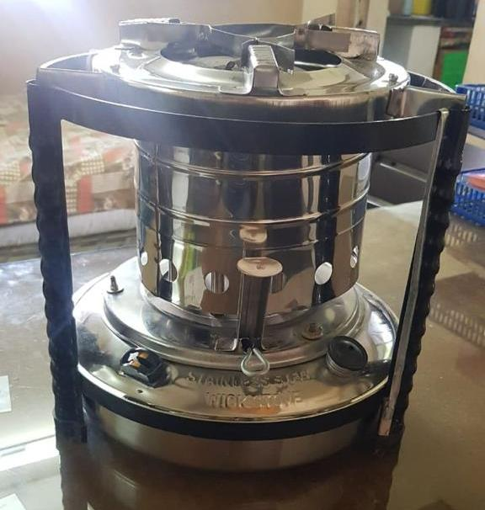
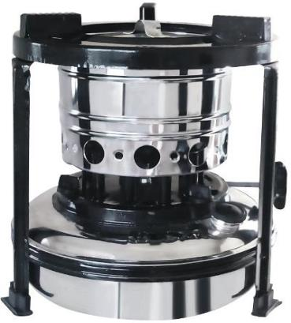
KEROSENE WICK STOVES CHROME PLATED

Slide 11
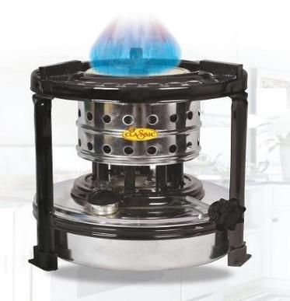
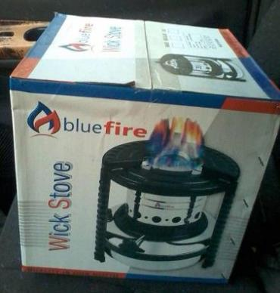
KEROSENE WICK STOVES CHROME PLATED

Slide 12
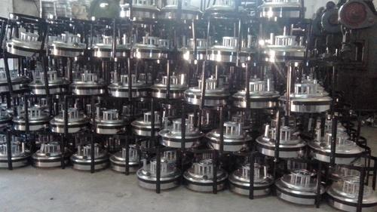
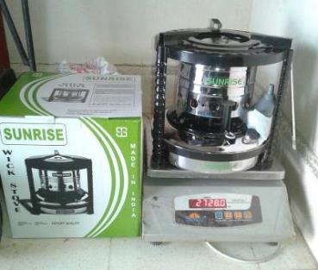
KEROSENE WICK STOVES CHROME PLATED

Slide 13
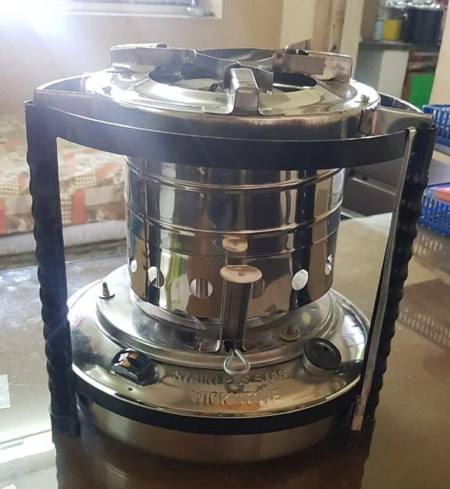
KEROSENE WICK STOVES STAINLESS STEEL

Slide 14
FEATURES AND SPECIFICATIONS
Model No.1
Burner : 12 wicks Tank capacity : 1 liter Single box size : 8.25" x 8.25" x 9.50" Master carton : 24 PCS Master carton size : 34.50" x 26.23" x 19.75“
Model No. 2
Burner : 10 wicks Tank capacity : 2 liter Single box size : 9.50" x 9.50" x 9.75" Master carton : 18 PCS Master carton size : 29" x 19.50" x 30“

Slide 15
FEATURES AND SPECIFICATIONS
Model No. 3
Burner : 10 wicks Tank capacity : 3 liter Single box size : 11" x 11" x 11.50" Master carton : 12 PCS Master carton size : 33.50" x 22.50" x 23.75“
Types : Chrome plated wick stove, Non- magnetic Wick stove, Stainless steel Wick stove
Kerosene Capacity : 1,2,3 litre capacity
Serves Domestic and Industrial purposes
Qualitative attributes : Durability, Anti corrosion, Resistance
High performance

Slide 16
CONTACT DETAILS: KISHORE CHANDNI (CEO) ADDRESS: F-14, HI-LIFE MALL, 1st FLOOR, P.M.ROAD, SANTACRUZ WEST, MUMBAI 400054 MAHARASHTRA, INDIA

Slide 17
THANK YOU info@sunriseexport.net

